Slide 1
CODE REVIEW

Slide 2
Criteria of evaluation
Naming - Convention used and choosing appropriate variables
Commented code - Are the comments sufficient and clear?
Simplicity and clarity - Levels of nesting ,Lines per function
Ease of reuse - Portable? Modular?

Slide 3
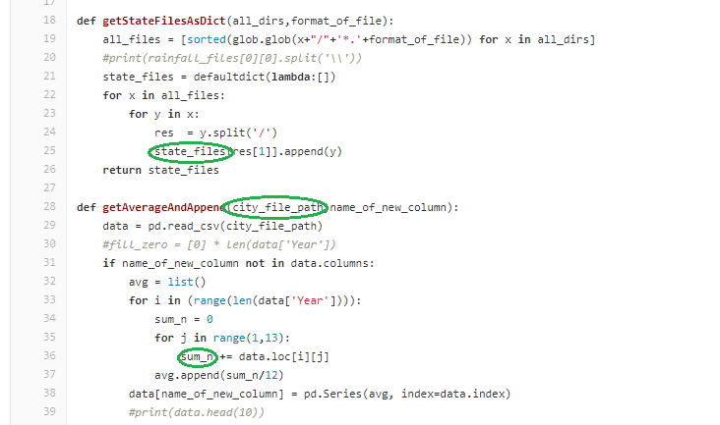
Naming
Consistent Convention
Two words in a compound variable name always separated with an _

Slide 4
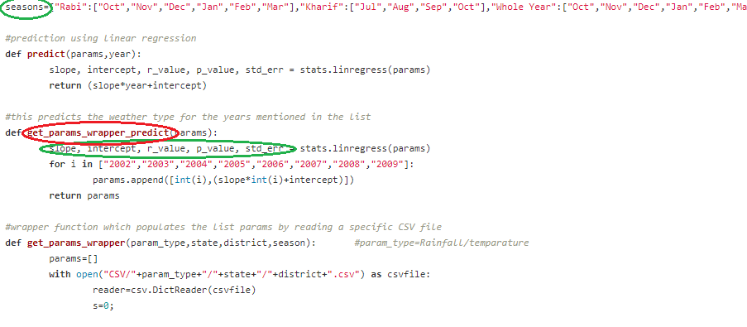
Naming
Appropriate variable names
While variables are named appropriately in most places, in some parts of the code it is not easy to figure out what the names stand for without reading comments

Slide 5
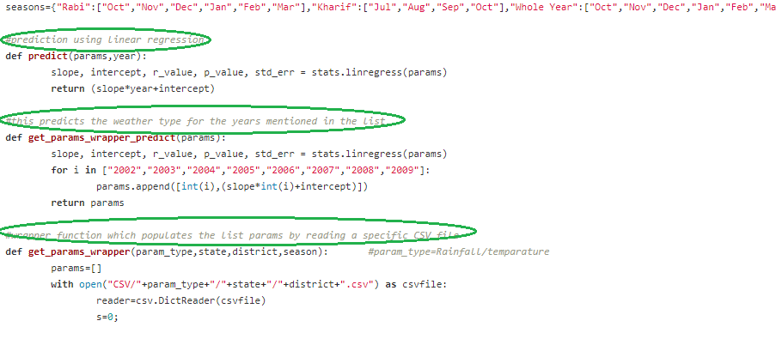
Comments in code
Sufficient and clear
The comments clearly state what each function is doing and they are sufficient to understand the summary of each part of the code

Slide 6
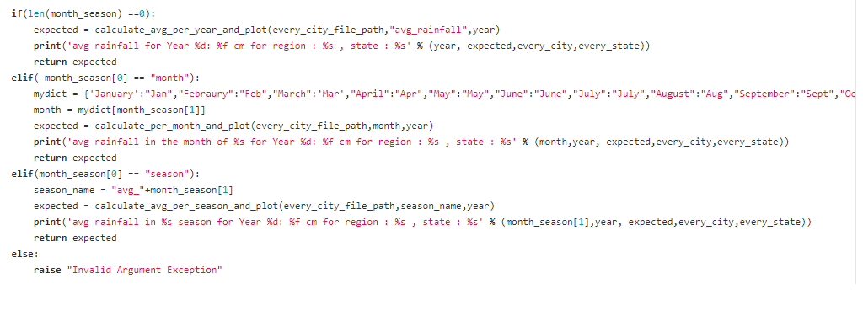
Simplicity and clarity
Levels of nesting
There aren't multiple levels of nesting making the code easy to understand

Slide 7
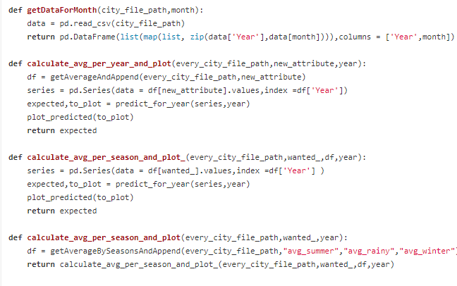
Simplicity and clarity
Lines per function
There are not too many lines in every function making the code easy to manage

Slide 8
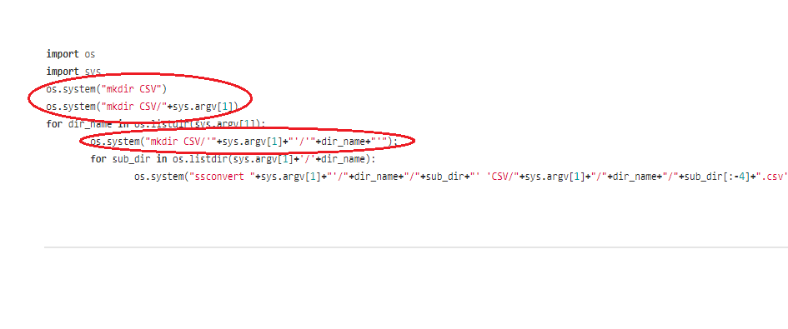
Ease of reuse
Portablity
The code is not portable and seems to only work on linux based systems. Code can use system independent functions such as os.mkdir(path) rather than os.system(mkdir path)

Slide 9
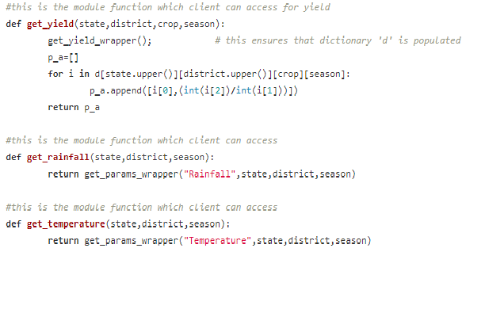
Portability
Modular
The code is modular - not evrything is dumped in one file and every file is split up into functions to perform different tasks.

